Slide 1
Statistics Boot Camp Business Analytics and Information Systems
Content and Presentation by :
Utkarsh Shrivastava

Slide 2
Key Topics
Descriptive Statistics
Basic Definitions
Data Types and Visualization
Data Description Measures
Statistics Theory
Probability Distributions
Sampling Distributions
Central Limit Theorem
Inferential Statistics
Confidence Intervals
Hypothesis Testing
Examples and Exercises using R

Slide 3
Statistics
Statistics concerns data; their collection, analysis and interpretation.
Two types of Statistics
Descriptive Statistics
Describe graphically and/or numerically a group of data.
Inferential Statistics
Take information contained in the sample and make statements about the population.

Slide 4
Basic Definitions:
Population
The entire set of data we are interested in learning about.
Sample
The subset of the population from which data has been collected
Experimental Unit
The object we measure to get the data we are going to study
Variable
The characteristic we collect that varies from one experimental unit to the next.
Parameter
A numerical characteristic of the population (usually unknown)
Statistic
A numerical characteristic of the sample (always known)

Slide 5
Example
We want to estimate the average length of time of all boot camps held in the College of Business. We sample ten of the most recent boot camps and find that the average length was 3 hours.
Population
Every boot camp held in the College of Business.
Sample
The 10 boot camps that data has been collected from.
Experimental Unit
A single boot camp in the College of Business.
Variable of Interest
The length of time
What about parameter, statistic ?

Slide 6
Types of Data
Univariate Data: In this type of data we analyze one variable per observation. E.g. In the earlier example, each observation pertains to a boot camp while the variable of interest is the length of time.
Bivariate Data: In this type of data we analyze two variables per observation related to the unit of interest. E.g. If we analyze the data related to the length of time and number of students in each boot camp then the data would be bivariate.
Multivariate Data: In this type of data we analyze more than two variables per observation related to the unit of interest. E.g. If we analyze the data related to the length of time, number of students attended and number of students registered in each boot camp then the data would be a multivariate data.

Slide 7
Univariate Data
The univariate dataset can be of following types:
Categorical (Qualitative)
Data that can be classified into one of several categories. E.g. gender of each student who attended the boot camps.
Numerical (Quantitative)
Data that are numerical by nature.
Two Sub Types :
Discrete - countable number of responses (jumps). E.g. Number of female / male participants in each boot camp.
Continuous - infinite number of responses (smooth).E.g. Average Height of each participant in a boot camp.

Slide 8
Visualizing Data (Categorical)
Some Terms to Remember
Class - categories that categorical variables fall into or groups that QN data are grouped into. E.g. If we are analyzing data related to gender of each student who has attended the current boot camp then our categorical variable (“Gender”) would have two categories or class i.e. Male or Female
Frequency - the number of occurrences of a class
Relative Frequency - the proportion of occurrences of a class

Slide 9
Example 1
Hypothetical Categorical Data ’gender’:
-----------------------------------
gender <- NULL ## Initialize a variable
gender <- c(“M”,”F”,”F”,”F”,”M”)
------------------------------------
# Structure of the character vector gender
> str(gender)
chr [1:5] "M" "F" "F" "F" "M„
#Number of unique classes in the categorical variable gender :
> length(unique(gender))
[1] 2
# Labels of unique classes in the variable gender
> unique(gender)
[1] "M" "F
# Frequency of each class in the categorical variable gender
> table(gender)
gender
F M
3 2
##Relative Frequencies
> table(gender)/length(gender)
gender
F M
0.6 0.4
Notes:
gender[1:40] <- "Male“ ## Assign “Male” to all indexes (assuming 40 people participated)
## Assigning the character value “Female” in all indexes that are divisible by 3
for(i in 1:40)
{ if(i%%3==0)
{ gender[i] <- "Female"}
}
# Frequency of each class in the categorical variable gender
> table(gender)
gender
F M
3 2
##Relative Frequencies
> table(gender)/length(gender)
gender
F M
0.6 0.4

Slide 10
Exercise
There are fifty states in US and they are assigned to a total of 9 divisions. The names of the state are stored in the data vector (“state.name”) and the corresponding division is stored in the data vector (“state.division”) of the base package of R.
Find the number of states in each of the nine divisions.
Write the R code for getting division with maximum states ?
Find which region has most number of unique divisions ? The names of the region are stored in state.region vector (Hint ; Create a data frame (mydat < data.frame(state.name,state.division,state.region) and run a loop to save required information)
Notes:
temp1 <- data.frame(table(state.division))
temp1[which(temp1$Freq==max(temp1$Freq)),1]
mydat <- data.frame(state.name,state.division,state.region)
## Strategy for each region I will find the number of unique states and then collect them in a dataframe
reg <- unique(mydat$state.region)
mat <- NULL
for(i in 1:length(reg))
{
mat$region[i] <- as.character(reg[i])
mat$unique_devisions[i] <- length(unique(mydat[mydat$state.region==reg[i],"state.division"]))
}

Slide 11
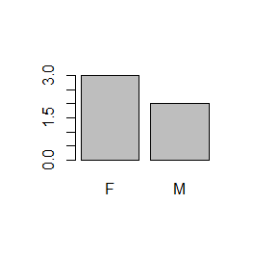
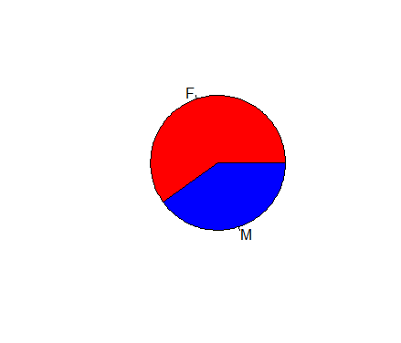
Visualizing Categorical Data
Bar Graph - bar lengths are determined by the (relative) frequency of the classes.
> barplot(table(gender))
Pie Chart - size of “slices” depends on the (relative) frequency of the classes.
> pie(table(gender),col = c("Red","Blue"))
How to edit axis labels and
titles in these plots ?

Slide 12
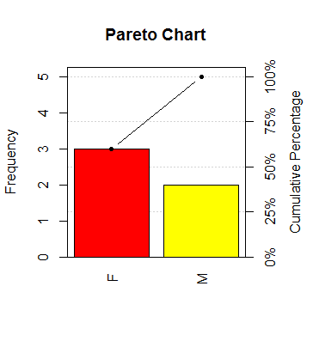
Pareto Diagram
A pareto diagram is a bar graph with bars arranged in such a way that their height decreases when going from left to right.
To draw a pareto graph use the package “qcc” in R.
>install.packages(qcc)
>library(qcc)
> pareto.chart(table(gender), ylab = "Frequency",main = "Pareto Chart")

Slide 13
Visualizing Numerical Data
Stem-and-Leaf Display data values are broken into “stems” and ‘leaves” to show where the data falls.
Suppose you have the estimate of number of students who participated in 10 boot camps within 2010-2017 in the participation variable.
R Script :
# Hypothetical data variable :
participation <- c(40,45,55,66,71,23,43,52,55,61)
#Command for stem plots
> stem(participation)
The decimal point is 1 digit(s) to the right of the |
2 | 3
3 |
4 | 035
5 | 255
6 | 16
7 | 1
What do we learn from this representation ?

Slide 14
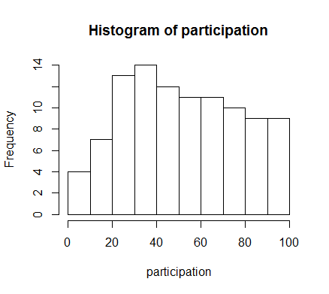
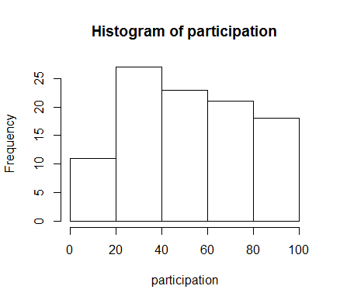
Histograms
> hist(participation)
Histogram Display: - both frequency and relative frequency bar graphs can be generated from the data.
Lets Generate a longer series :
# Random generation of 100 numbers between 1 to 100 representing participation in 100 boot camps
set.seed(100) #So that we get the same random sample each time we run the sampler.
participation = sample(1:100,100,replace=T)
# An integer vector with 100 values.
>hist(participation,breaks = 5)

Slide 15
Describing Numerical Data
Displaying data using plots such as histograms gives us visual insights but does not tell about the mean and spread of the data. Therefore, numerical descriptive techniques are used to describe the data. Lets assume that the
Measures of central location of the data distribution:
Mean - arithmetic average ( R > mean(data_vector))
Median - middle of the ordered data (> median(data))
Mode - most frequent value in the data vector (No built in function in R, what to do)
Advantages and disadvantages of these measures of central tendency.
Notes:
If n is odd, the median is the middle number
If n is even, the median is the average of the 2 middle numbers

Slide 16
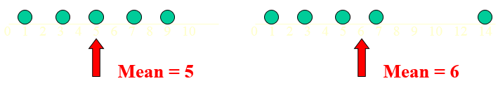
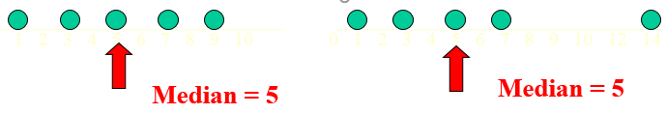
Key Points
The mean is easy to evaluate but is effected by the extreme values in the data.
The median and mode are not effected by the extreme values
Some points to ponder about :
What would be median of a numerical vector with even number of total elements ?
In it possible that a data vector has no mode or many modes.

Slide 17
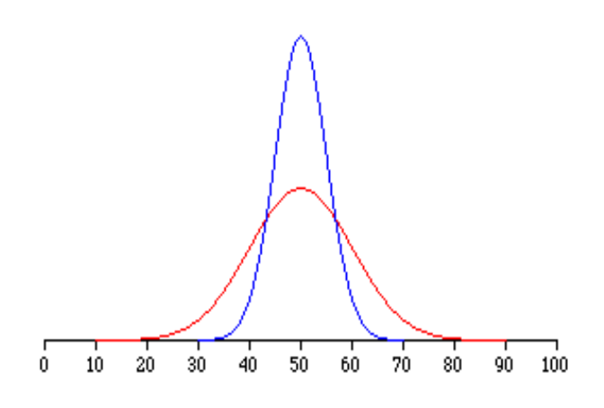
Measures of Variation
Informs about the spread of data across the mean.
Range - Difference between the largest and
smallest observations. R Function > range(data)
Variance - sum of the squared deviations of the
observations from their mean, divided by (n-1)
where n is the size of the sample. R Function > var(data)
Why do we need these measures along with central tendency measures ?

Slide 18
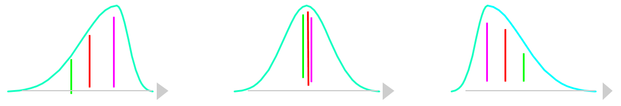
Shape of the Data
Measures of variations tells about the variation in the dataset while the measures of shapes such as “Skewness” and “Kurtosis” tells about the direction of variation in the dataset.
Kurtosis characterizes the relative pawedness or flatness of the distribution compared to the normal. If the peak Is flatter than normal then kurtosis < 0 while if the peak sharper than normal than kurtosis > 0. It is however harder to interpret from the naked eyes.
Left – Skewed
Skewness < 0
Symmetric
Skewness = 0
Right Skewed
Skewness > 0
Mean < Median < Mode
Mean = Median = Mode
Mode < Median < Mean

Slide 19
Example : Consider Three Data Series
set.seed(100) #So that we get the same random sample each time we run the sampler.
data1 <-c(sample(1:30,60,replace=T),sample(30:70,20,replace=T),sample(70:100,20,replace=T))
data2 <- c(sample(1:30,20,replace=T),sample(30:70,20,replace=T),sample(70:100,60,replace=T))
data3 <- c(sample(1:45,20,replace=T),sample(45:55,60,replace=T),sample(55:100,20,replace=T))
install.packages("e1071") # For Calculating Skewness and Kurtosis
library(e1071)
skewness(data1);skewness(data2);skewness(data3); kurtosis(data1);kurtosis(data2);kurtosis(data3)
Exercise : Plot histograms of these series and locate mean and median on the plots. Superimpose density plots on the histograms.
#Script for graphing the distribution of data series
hist1 <- hist(data1,probability = T,plot = FALSE)
hist(data1,probability = T,xlim = c(0,100),ylim = c(0,max(hist1$density)),main = "Histogram for Data1",xlab = "Participation",ylab = "Proportion")
par(new = TRUE) # To plot one graph over another
plot(density(data1),xlim = c(0,100),ylim = c(0,max(hist1$density)),xlab = NA,ylab = NA,main = NA,lty= 2)
# Locating mean and median in this plot.
abline(v = mean(data1), col = "green")
abline(v = median(data1), col = "red")
legend("topright",c("Mean","Median"),col = c("green","red"),lty = c(1,1))

Slide 20
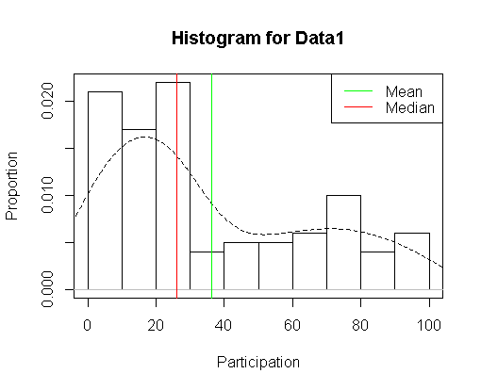
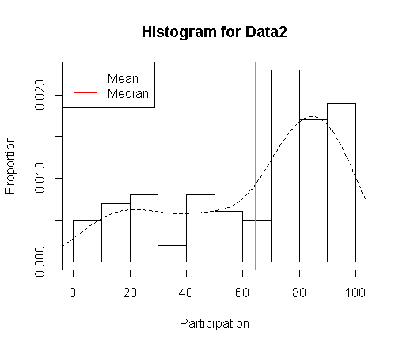
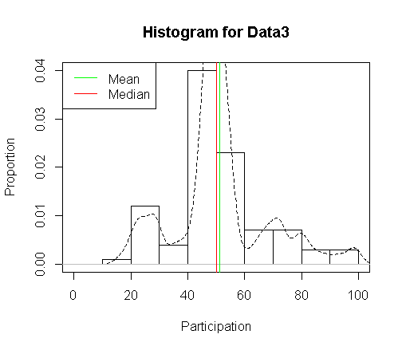
Output
Note : To plot graphs using earlier script replace “data1” in all plotting functions by “data2” and “data3”

Slide 21
Exercise
Use the ChickWeight dataset in the base package of R to plot the distribution of weights (density plot) of chicks that are 10 year old for each of the four diets. All four density plots should be on the same window so that comparisons can be made.
Notes:
#Visualize the distribution of weights of 10 day old chicks on all four diets
d1 <- density(dat1[dat1$Time==10 & dat1$Diet==1,"weight"])
d2 <- density(dat1[dat1$Time==10 & dat1$Diet==2,"weight"])
d3 <- density(dat1[dat1$Time==10 & dat1$Diet==3,"weight"])
d4 <- density(dat1[dat1$Time==10 & dat1$Diet==4,"weight"])
ylm <- c(0,max(d1$y,d2$y,d3$y,d4$y))
xlm <- c(min(d1$x,d2$x,d3$x,d4$x),max(d1$x,d2$x,d3$x,d4$x))
xlb = "Weight"
ylb = "Proportion"
plot((d1),col = "red",xlim = xlm,ylim = ylm,xlab = xlb,ylab=ylb,main = NA)
par(new = TRUE)
plot((d2),col = "blue",xlim = xlm,ylim = ylm,xlab = xlb,ylab=ylb,main = NA)
par(new = TRUE)
plot((d3),col = "green",xlim = xlm,ylim = ylm,xlab = xlb,ylab=ylb,main = NA)
par(new = TRUE)
plot((d4),col = "orange",xlim = xlm,ylim = ylm,xlab = xlb,ylab=ylb,main = NA)
legend("topleft",c("Diet1","Diet2","Diet3","Diet4"),lty = c(1,1,1,1),col = c("red","blue","green","orange"))

Slide 22
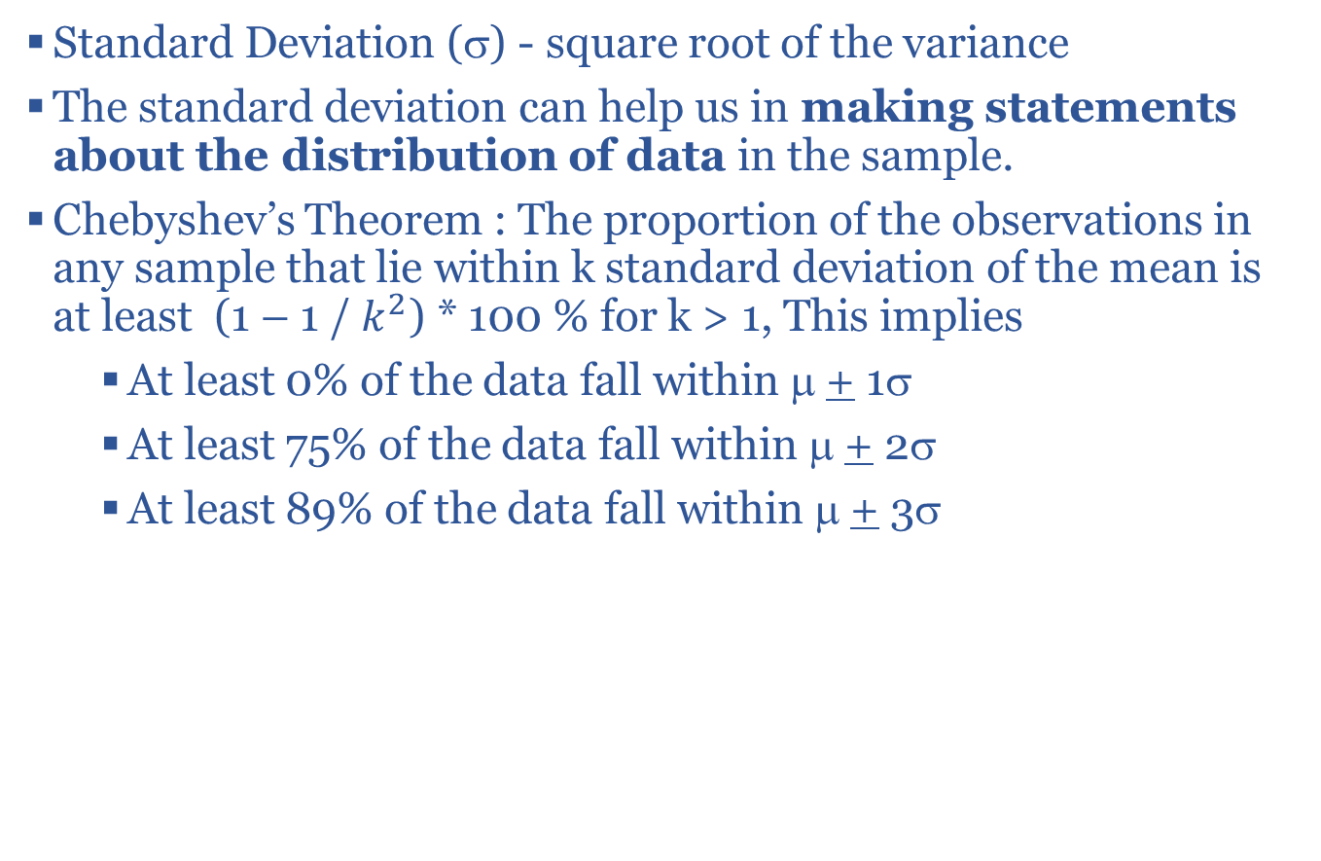
Standard Deviation and Its Applications
Standard Deviation (σ) - square root of the variance
The standard deviation can help us in making statements about the distribution of data in the sample.
Chebyshev’s Theorem : The proportion of the observations in any sample that lie within k standard deviation of the mean is at least (1 – 1 / $k^{2}$) * 100 % for k > 1, This implies
At least 0% of the data fall within μ + 1σ
At least 75% of the data fall within μ + 2σ
At least 89% of the data fall within μ + 3σ
# Test if the theorem applied to the series data3 or not
sd1 <- sd(data3)
mean1 <- mean(data3)
# % of Observations between 2 standard deviation across mean
mean(ifelse(data3 >=(mean1-2*sd1) & data3<=(mean1+ 2*sd1),1,0))
What is your answer ?
Notes:
str(ChickWeight)
#Visualize the distribution of weights of 10 day old chicks on all four diets
dat1 <- ChickWeight
d1 <- density(dat1[dat1$Time==10 & dat1$Diet==1,"weight"])
d2 <- density(dat1[dat1$Time==10 & dat1$Diet==2,"weight"])
d3 <- density(dat1[dat1$Time==10 & dat1$Diet==3,"weight"])
d4 <- density(dat1[dat1$Time==10 & dat1$Diet==4,"weight"])
ylm <- c(0,max(d1$y,d2$y,d3$y,d4$y))
xlm <- c(min(d1$x,d2$x,d3$x,d4$x),max(d1$x,d2$x,d3$x,d4$x))
xlb = "Weight"
ylb = "Proportion"
plot((d1),col = "red",xlim = xlm,ylim = ylm,xlab = xlb,ylab=ylb,main = NA)
par(new = TRUE)
plot((d2),col = "blue",xlim = xlm,ylim = ylm,xlab = xlb,ylab=ylb,main = NA)
par(new = TRUE)
plot((d3),col = "green",xlim = xlm,ylim = ylm,xlab = xlb,ylab=ylb,main = NA)
par(new = TRUE)
plot((d4),col = "orange",xlim = xlm,ylim = ylm,xlab = xlb,ylab=ylb,main = NA)
legend("topleft",c("Diet1","Diet2","Diet3","Diet4"),lty = c(1,1,1,1),col = c("red","blue","green","orange"))

Slide 23
Other Rules
Empirical Rule – works for bell-shaped or symmetric data
Approximately 68% of the data fall within μ + 1σ
Approximately 95% of the data fall within μ + 2σ
Approximately 100% of the data fall within μ + 3σ
Modified Empirical Rule – works for skewed data
Approximately 60-90% of the data fall within μ + 1σ
Approximately 90-100% of the data fall within μ + 2σ
Approximately 100% of the data fall within μ + 3σ
For most data sets we find in business, most observations will lie within two standard deviations of their mean.

Slide 24
Describing Numerical Data
Measures of Relative Standing
Percentiles - p^{th} percentile is the point /value at which p% of the data fall below. For example, 45th percentile for the data series “data1” is 23 which implies that 45% of the observations in the data1 are below 23.
Common Terms:
--- Lower Quartile – 25th percentile
--- Upper Quartile - 75th percentile
Z-scores – tell us how many standard deviations an observation falls from the mean and in which direction.
Z = (x - µ) / σ
The Z for the observation 19 in the data series “data1” is -0.57 which implies that 19 is 0.57 standard deviations below the mean.
> quantile(data1, probs = c(0.45))

Slide 25
Some Applications
Suppose a data series has a mean μ = 50 and the standard deviation of 10. Using the Chebyshev’s theorem find out the limits a and b that contain 80% of the values.
Suppose you secured 80 points in ISM111 and 90 points in ISM222. While, mean and standard deviation of the scores for ISM111 was 85 and 10 while for ISM222 it was 92 and 8. Can you tell in which class did you performed relatively better.
Notes:
Ans (1-1/k^2) = 0.8 => k^2 = 5 => k = 2.23 => 50 - 2.23*10 and 50 + 2.23*10

Slide 26
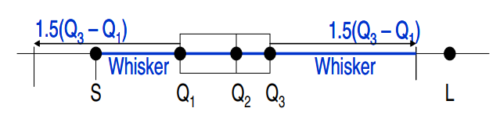
Outliers
The observations that lie outside the pattern of the data distribution (Moore and McCabe 1999). The presence of an outlier may be an indicator of an error in measurement or an rare anomaly impacting the data sampling process.
Outliers in the data should to investigated to ensure if there were any measurement problems or not.
Outliers can be detected using the following two methods :
Z-Score Method : Generally a data element with absolute z-score of greater than 2 (for skewed) and 3 (for symmetric) is considered as the outlier.
Box Plot Method : The points beyond inner fence [(Q1-1.5*IQ),(Q3+1.5*IQ)] are considered mild outlier while the points beyond outer fence [(Q1-3*IQ),(Q3+3*IQ)] are considered extreme outlier
Q1 = First Quartile
Q2 = Median
Q3 = Third Quartile
Notes:
Moore, D. S. and McCabe, G. P. Introduction to the Practice of Statistics, 3rd ed. New York: W. H. Freeman, 1999.

Slide 27
R Script for Outlier Detection
# Using series data3 for detecting outlier
sd <- sd(data3)
mean <- mean(data3)
z_data <- (data-mean1)/sd1 # A vector of Z-Scores of each observation
> summary(z_data)
Min. 1st Qu. Median Mean 3rd Qu. Max.
-1.9620 0.4864 0.7802 0.7360 1.0040 3.4110
# For some values Z-score is less than -3
# Identifying the index of elements with Z-Score more than 3
index <- which(abs(z_data1)>2)
> Index #Location of the Outlier
[1] 9 13 14 20 86 87 88 98
> data3[index] #Values of Outliers in the Series
[1] 4 10 14 2 86 89 98 89

Slide 28
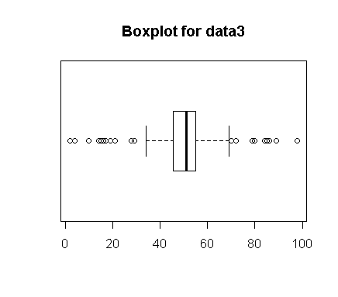
Box Plots
#Boxplot
boxplot(data3,horizontal = T,main = "Boxplot for Data3")
#Outliers
Q3 <- quantile(data3, probs = c(0.75))
Q1 <- quantile(data3, probs = c(0.25))
IQ <- Q3-Q1
L1 <- Q1-3*IQ
L2 <- Q3+3*IQ
#Index of Outlier Elements
index <- c(which(data3 < L1),which(data3 > L2))
#Value of Outlier Elements
data3[index]
Notes:
http://www.itl.nist.gov/div898/handbook/prc/section1/prc16.htm
http://faculty.salisbury.edu/~dccathcart/MATH155/ClassSessions/FindingOutliers.pdf

Slide 29
Measures of Relationships
Covariance : Covariance measures whether or not two variables move together.
Correlation : The coefficient of correlation is designed to measure the strength of the relationship between two variables.
Correlation coefficient always lies between -1 and 1.
A value close to 1 indicates strong positive relationship while a value close to -1 indicates strong negative relationship.
Use cov and cor functions in R to calculate covariance and correlation
Exercise : Use quakes dataset to identify relationship between depth of the quake and magnitude at rector scale for quakes that are reported by at least 20 stations.

Slide 30
Probability Distributions
The probability distribution function describes the probabilities of different possible outcomes in an experiment. For example, if tossing a coin in an experiment that has a set of outcomes X (heads and tails) then the distribution of X can be represented as P(X=heads) = 0.5 and P(X=tails) = 0.5.
Depending on the outcome of the experiment the distributions can be
Discrete or Continuous
Common Discrete Distributions
Binomial
Poisson
Hypergeometric
Common Continuous Distributions
Normal
Uniform
Exponential

Slide 31
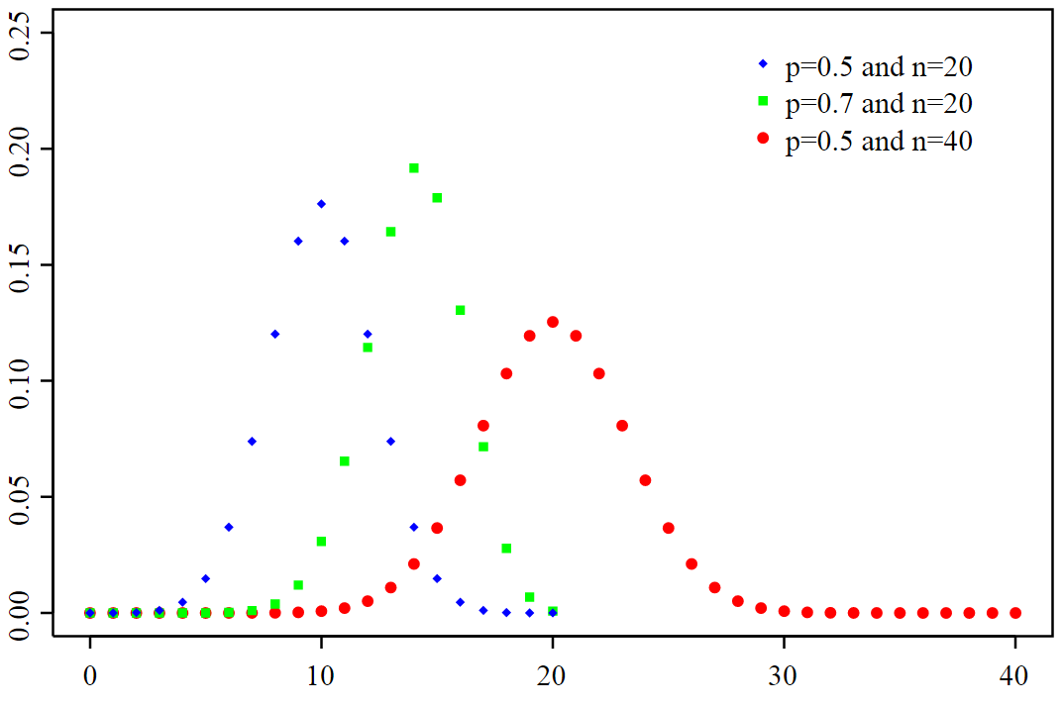
Binomial Distribution
If an experiment has n trails and two outcomes (e.g. success or failure) with success probability of p then this function models the probability of getting ‘X’ success in n trials.
The number of trials ‘n’ and the success probability ‘p’ determines the shape of discrete data that is binomially distributed.
Example, suppose we are throwing a biased dice 10 times such that probability of getting heads on each throw is 0.5 then what is the probability that 7 heads with appear in 10 attempts. Hence, in this case Binomial probability distribution can give us estimate of probability of 7 heads.
The R function dbinom(No of Success, n ,p) can be used to calculate the probability of 7 successes (heads) in 10 trials with probability p = 0.7
> dbinom(7,10,0.7)
[1] 0.2668279
The shapes of data distributed as binomial distribution for various values of trial (n) and success probability (p).
X-Axis: Number of successes
Y-Axis : Probability

Slide 32
Percentile / Quantile of Distribution
From earlier discussion we know that nth percentile of a data distribution is a value which has n% of all possible data values below it. For instance, a 90th percentile of a binomial distribution with 10 trials (n = 10) and 0.7 success probability (p=0.7) would be equal to number of success or heads in 10 trials which would be greater than 90% of the values from this distribution.
qbinom(percentile,n,p) function can be used to computer required percentile.
> qbinom(0.8,size = 100,prob = 0.7)
[1] 74
What does this mean ?
Alternatively, the cumulative distribution of a binomial distribution function can be used to predict the percentage of outcomes that are below a certain value.
> pbinom(7, size=10, prob=0.7)
[1] 0.6172172 # This means that 61% of the values would be below 7.

Slide 33
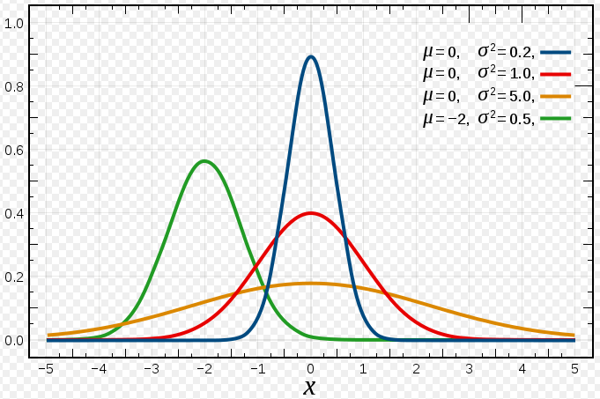
Normal Distribution
Normal distribution is used to model the probabilities of continuous outcome of an experiment.
For example, the height of the wheat plants in the fields can be considered to be normally distributed with a certain mean say 200cm and a standard deviation of 20 cm.
A normal distribution is described by two parameters : the mean µ and standard deviation σ.
The shape of the data distribution of a normally distributed variable is symmetrical and bell shaped with equal mean, median and mode.
Shapes of distribution of a normally distributed data for various values of mean (µ) and deviation (σ) parameters.

Slide 34
Some Applications
Given the data is normally distributed with mean m and standard deviation s the following functions are useful
dnorm(X,mean = m, sd = s) # For calculating probability of getting X assuming data is normally distributed with mean m and standard deviation s.
pnorm(X,mean = m, sd = s) # For calculating the proportion of values or outcomes that are less than or equal to X.
qnorm(N, mean = m, sd = s) # For calculating the Nth percentile for the data normally distributed with mean = m and standard deviation = s.
For example assume that height of wheat plants in the field is normally distributed with mean 100 cm and standard deviation of 10cm, then :
What is the probability that the length of a plant is 200cm ?
What percentage of plants will have height less than or equal to 20 cm ?
What percentage of plants will have height between 50 to 90 cm ?
It is safe to that 80% of the plants will have height less than _____ ?
Notes:
dnorm(200,mean = 100, sd = 10)
pnorm(90,100, 10) - pnorm(50, 100, 10)

Slide 35
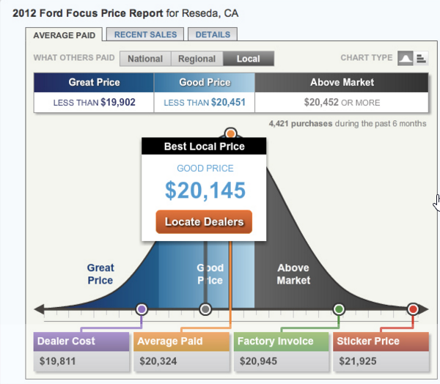
Exercise
Suppose we know that the mean sales price is $20,324 and the standard deviation is $533.67. What percentage of the buyers paid “above market?” What percentage got a “great price?”
Notes:
1- pnorm(20452,…)
Pnorm(19,902)

Slide 36
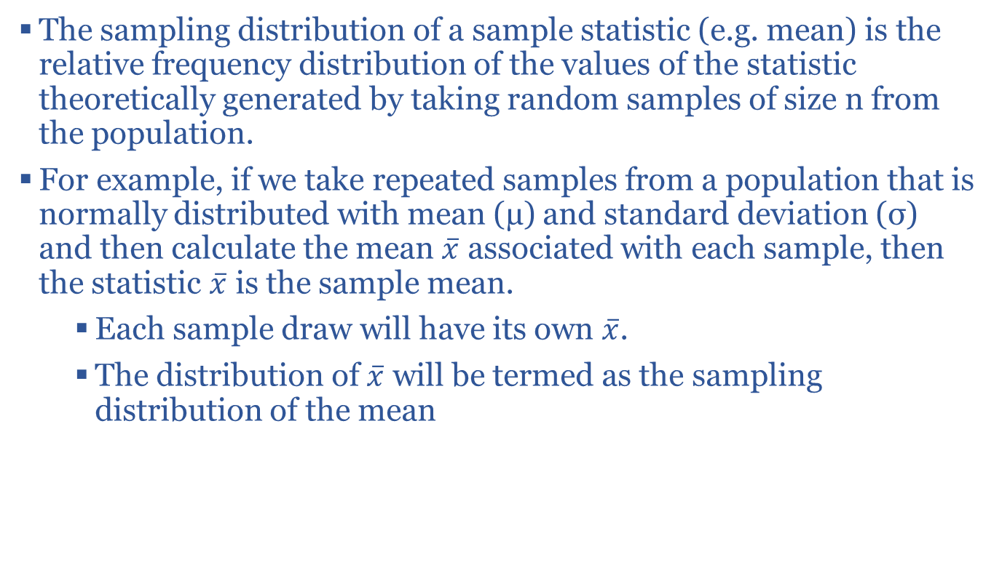
Sampling Distribution
The sampling distribution of a sample statistic (e.g. mean) is the relative frequency distribution of the values of the statistic theoretically generated by taking random samples of size n from the population.
For example, if we take repeated samples from a population that is normally distributed with mean (µ) and standard deviation (σ) and then calculate the mean $\overline{x}$ associated with each sample, then the statistic $\overline{x}$ is the sample mean.
Each sample draw will have its own $\overline{x}$.
The distribution of $\overline{x}$ will be termed as the sampling distribution of the mean

Slide 37
CENTRAL LIMIT THEORM
The theorem states that if n (the sample size from the random draw) is sufficiently large (n >= 30), then the sampling distribution of the sample mean follows a normal distribution.
The theorem works even if the population from which we are drawing samples is not normally distributed.
The availability of sampling distribution of statistic such as mean allows for formulating hypothesis and making statistical inference about the population mean.

Slide 38
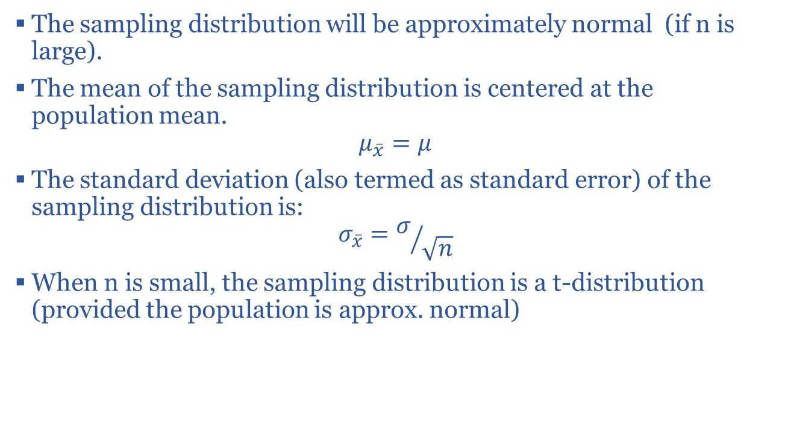
Properties of Sampling Distribution of Sample Mean
The sampling distribution will be approximately normal (if n is large).
The mean of the sampling distribution is centered at the population mean.
$$μ_{\overline{x}}=μ$$
The standard deviation (also termed as standard error) of the sampling distribution is:
$$σ_{\overline{x}}=σ/{\sqrt{n}}$$
When n is small, the sampling distribution is a t-distribution (provided the population is approx. normal)

Slide 39
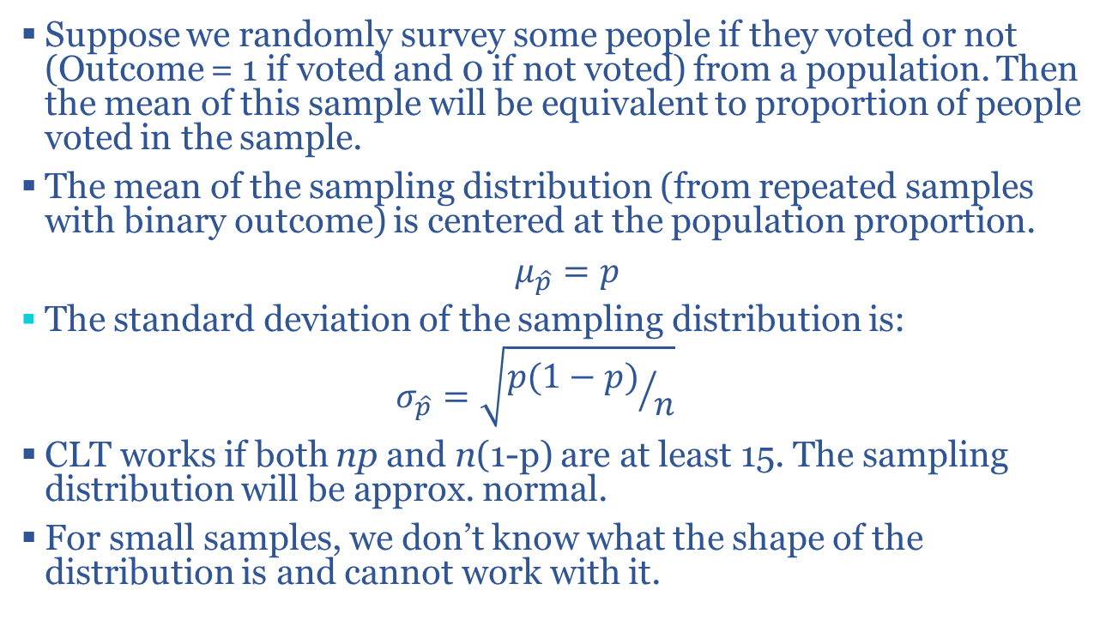
Sampling distribution of sample proportion
Suppose we randomly survey some people if they voted or not (Outcome = 1 if voted and 0 if not voted) from a population. Then the mean of this sample will be equivalent to proportion of people voted in the sample.
The mean of the sampling distribution (from repeated samples with binary outcome) is centered at the population proportion.
$μ_{\hat{p}}=p$
The standard deviation of the sampling distribution is:
$$σ_{\hat{p}}=\sqrt{{p(1−p)}/n}$$
CLT works if both np and n(1-p) are at least 15. The sampling distribution will be approx. normal.
For small samples, we don’t know what the shape of the distribution is and cannot work with it.

Slide 40
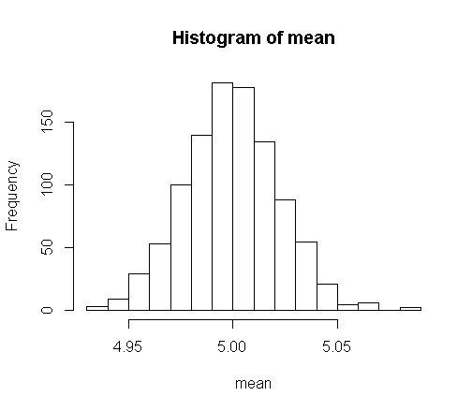
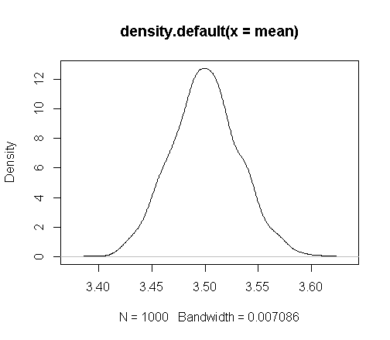
Showing CLT works
# Sample from a Binomial distribution with parameters ‘n’ and ‘p’ and sample size ‘s’
n = 5; p = 0.7 ; s = 1000
# Sample 1000 times from the distribution and save the mean in the vector mean
mean <- NULL
for(i in 1:1000) # rbinom for generating s random draws
{mean[i] <- mean(rbinom(s,size = n,prob = p))}
hist(mean); plot(density(mean))
# Change the values of s,p and n and still the mean statistic would be normally distributed.
# Sample from a Normal distribution with parameters ‘m’ and ‘sd’ and sample size ‘s’
m = 5; sd = 0.7 ; s = 10 ;
# Sample 1000 times from the distribution and save the mean in the vector mean
mean <- NULL
for(i in 1:1000)
{
mean[i] <- mean(rnorm(s,mean = m,sd = sd))
}
hist(mean)
plot(density(mean))

Slide 41
Confidence Intervals
We could use statistics such as sample mean or sample proportion (for binary data) to get an estimate of population mean.
But since the sample is random and therefore so is the statistic associated with it (i.e. sample mean may or may not be equal to the population mean).
Statistical theory relies on sampling distribution of some statistic such as mean (CLT tells about distribution of sample mean)
The knowledge of sampling distribution allows to make probability statements about population parameters such as “with 95% (confidence level) certainty we can say that the population mean lies in some interval a and b.
The interval [a,b] is called the confidence interval at 95% level of confidence.

Slide 42
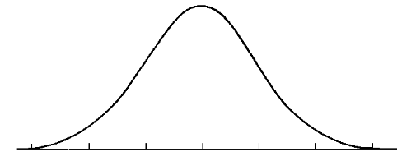




Confidence Interval Theory
According to Central Limit Theorem for averages :
(Sample Mean – Population Mean)/(sd / $\sqrt{n}$) ~ N(0,1)
Therefore, based on properties of the Standard Normal Distribution we can infer about the population mean.
Approximately 95% of the sample mean would fall between two standard deviation lines.
$$μ−2σ_{\overline{x}}$$
$$μ$$
$$μ+2σ_{\overline{x}}$$

Slide 43
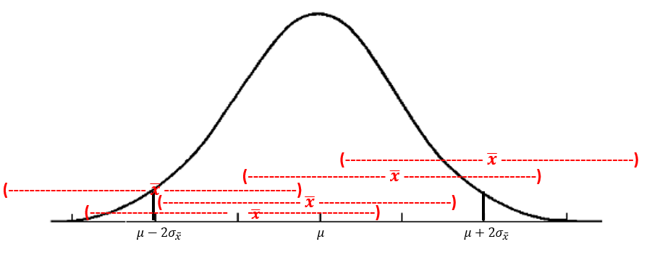
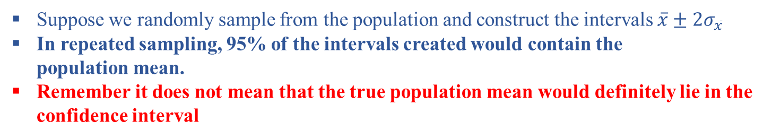
Confidence Interval Theory
Suppose we randomly sample from the population and construct the intervals $\overline{x}±2σ_{\overline{x}}$
In repeated sampling, 95% of the intervals created would contain the
population mean.
Remember it does not mean that the true population mean would definitely lie in the
confidence interval

Slide 44
Some Applications (Scenario 1)
When population standard deviation is known and sample size is more than 30
Suppose, we randomly sample the GRE scores (in variable “gre”) of 40 students in the MS BAIS program at USF. The population of these scores is believed to be normally distributed with 10 standard deviation. Determine and interpret the 95% and 99% confidence interval of the population mean.
# Hypothetical Data Generation
set.seed(100)
gre <- sample(275:325, size = 40, replace = TRUE)
# Use function z.test to calculate confidence interval.
install.packages("BSDA")
library(BSDA)
# Use z.test when sd is known
z.test(gre, sigma.x = 10,conf.level = 0.80)
95 percent confidence interval:
298.301 304.499
Conclusion : With 95% confidence we can say that the mean GRE scores of the students lies in the interval 298 – 384.
Note : Saying “there is a 95% chance that mean lies in the interval of 298 – 384 is wrong.

Slide 45
Scenario 2
The sample size is less than 30 or population variance is not known
When the population variance is not known or sample size is less than 30 t-distribution is preferred to infer about the population mean from the sample.
The command t.test in the base package of R can be used to get the confidence interval.
Would interval expand or shrink with reduction in confidence level ?
Would interval expand or shrink with increase in sample size ?
set.seed(100)
# This time use sample size 20
gre <- sample(275:325, size = 20, replace = TRUE)
t.test(gre,conf.level = 0.95)
95 percent confidence interval:
291.564 304.036

Slide 46
Scenario 3
Confidence interval for the binary data.
For example, you want a 95% confidence interval on the proportion of MS BAIS students who have score of more than 100 on the TOEFL exam.
You randomly select 50 students and found that 30 of them had a score of 100 or more in TOEFL.
Since sample proportion may not be equal to the true population proportion, you want to construct a 90% confidence interval for the proportion of students with more than 100 score on TOEFL.
Use prop.test() of R to find it.
Therefore, we are 90% confident that 47% - 71% of the students would have a score of more than 100 on TEOFL
prop.test(x = 30,n=50,conf.level = 0.90)
90 percent confidence interval:
0.4738505 0.7150062
#x is the number of successes aka number of students with more than 100 score on TOEFL.
#n is the total number of trails

Slide 47
Exercise
Use the “ChickWeight” dataset in R to answer the following questions.
What is the 95% confidence interval for the weights of chicks aged between 20-22 days for each of the four diets ?
Use the “HairEyeColor” dataset in the base package of R to answer the following questions:
Irrespective of the eye color, what percentage of male and females have blond hair color ? (answer by constructing a 95% confidence interval)
Notes:
Code :
d1<- dat1[dat1$Time %in% 20:22 & dat1$Diet == 1,"weight"]
t.test(gre,conf.level = 0.95)
sum(dat1[4,1:4,1]) / sum(dat1[1:4,1:4,1])

Slide 48
Answering more questions: Hypothesis Testing
Useful for comparing the value of an unknown parameter to some specified point of interest.
In these tests an analyst makes a hypothesis about the value of the unknown population parameter and then calculate how likely it is given the observed data.
Using the sample data you may use these tests to answer following questions about the population parameter:
Do the mean gre scores of MS MIS students equal to 300.
Do gre scores of MS MIS students is different from that of MS CS students ?

Slide 49
Steps in Hypothesis Testing
State the null hypothesis and the alternate hypothesis
Null Hypothesis: Statement about the value of a population parameter.
Alternate Hypothesis: Statement that is accepted if evidence proves null hypothesis to be false.
Select the appropriate test statistic and level of significance (α).
E.g. when testing the hypothesis of a proportion, we use the z
-statistic or z-test and the formula.
α = P(Type I Error)
β = P(Type II Error)

Slide 50
Continued..
3. State the Decision Rules; The decision rules state the conditions under which the null hypothesis will be accepted or rejected. E.g. when test statistic is more than the critical value
4. Compute the test statistics and make final decision : The comparison of test statistics and the critical value (determined by α) is done to reject or fail to reject the null hypothesis.
5. Interpret the results : The p-value generally produced by all the statistical softwares’ is used to determine if to ‘reject null’ or ‘fail to reject’ null.
If α > p-value, we reject H₀.
If α < p-value, we fail to reject H₀.
Thankfully, there are lots of software's available to do all the necessary computation for the hypothesis testing.

Slide 51
Application
Suppose our department conducts an alumini salary survey (50 students in total). The department expects that average salary of the graduates is 100k. Based on the sample data (‘salary’) you have to answer the following question:
Do you think that salary significantly differs from 100k.
set.seed(100)
# Generate hypothetical data for 50 alumini
salary <- sample((80000:120000),50, replace = TRUE)
# Perform t-test as variance is not known, mu is the mean for the null hypothesis
# conf.level (Confidence Level) -> (1-alpha( Level of significance))
t.test(salary, alternative='two.sided', mu=100000, conf.level=.95)
Outcome : t = -0.25399, df = 49, p-value = 0.8006
alternative hypothesis: true mean is not equal to 1e+05
What do you learn ?
P-value = 0.8 > α (which is 0.05)
Therefore, we fail to reject null that the average salary of the graduates is 100k.
Note:
P-value tells us that how likely is the data given a true null hypothesis.
The level of significance is the probability of rejecting null when it is true.
Notes:
Confidence level is the probability of accepting the null hypothesis when it is true.

Slide 52
More Examples
However, some optimistic students feel that the average salary is significantly greater than 110k. Kindly check this hypothesis.
Since, p-value is not less than α (0.05) we fail to reject null therefore, we would not conclude that salary is greater than 110k
A pessimistic student thinks that average salary is less than 80k. Can you test this hypothesis
What do you think ?
t.test(salary, alternative='greater', mu=110000, conf.level=.95)
Output:
t = -5.6061, df = 49, p-value = 1
alternative hypothesis: true mean is greater than 110000
t.test(salary, alternative=‘less', mu=80000, conf.level=.95)
Output:
t = 10.45, df = 49, p-value = 1
alternative hypothesis: true mean is less than 80000

Slide 53
Two Sample Tests (Independent Samples)
Suppose, we survey 50 alumni from MS MIS and MS CS. We are interested in testing if there is a significant difference in the salary of MIS and CS graduates.
How do you interpret these results ?
set.seed(100)
# Hypothetical data generation
mis <- rnorm(50,mean = 110000,sd = 10000)
cs <- rnorm(50,mean = 100000,sd = 30000)
summary(mis);summary(cs)
# Two sample T-test to test if difference in mean is different than 0.
t.test(mis,cs,alternative="two.sided",mu=0,conf.level=0.95)
# p-value = 0.01, Null Accepted / Rejected ?
# To test if MIS Salary is greater than CS salary
t.test(mis,cs,alternative="greater",mu=0,conf.level=0.95)
# p –value = 0.0007, Accepted / Rejected ?
# To test if MIS salary is less than CS salary
t.test(mis,cs,alternative="less",mu=0,conf.level=0.95)
# Null Accepted / Rejected ?

Slide 54
Exercise
Consider the "CheckWeight" dataset and find the average weight of all chicks at time = 20 days after their birth. For all four diets test if the weight of the chicks at time =20 days is significantly different from the estimated mean. You can use 95% confidence level to make your decision.
If you find that for some diets the weight of chicks is different from the mean determine if it is greater or less than the mean.
In the “quakes” dataset test if there is a significant difference in the magnitude of the earthquakes that take place at at the depth of more than 250 meters.
Notes:
dat1 <- ChickWeight
m_weight <- mean(dat1[dat1$Time==20,"weight"])
## For diet 1
t.test(dat1[dat1$Time==20 & dat1$Diet==1,"weight"], alternative='two.sided', mu=m_weight, conf.level=.95)
t.test(dat1[dat1$Time==20 & dat1$Diet==2,"weight"], alternative='two.sided', mu=m_weight, conf.level=.95)
t.test(dat1[dat1$Time==20 & dat1$Diet==3,"weight"], alternative='two.sided', mu=m_weight, conf.level=.95)
t.test(dat1[dat1$Time==20 & dat1$Diet==4,"weight"], alternative='two.sided', mu=m_weight, conf.level=.95)
# Conclusion : The mean weight of chicks on diet 1 and 3 is significantly different from the mean at the age of 20 days.
# Post initial test
t.test(dat1[dat1$Time==20 & dat1$Diet==1,"weight"], alternative='less', mu=m_weight, conf.level=.95)
t.test(dat1[dat1$Time==20 & dat1$Diet==3,"weight"], alternative='greater', mu=m_weight, conf.level=.95)
# Quakes Problem
## Quakes Problem
dat2 <- quakes
# Stations and the magnitude of the quakes
stat_fre <- data.frame(table(dat1$stations))
# Indeitfy all the quakes with more than 10 earth quakes
stat1 <- stat_fre[stat_fre$Freq >= 10,"Var1"]
## Have a vector that saves the station number and the p-value of the t-test
mat <- NULL
r_scale <- 5
for(i in 1:length(stat1))
{
temp1 <- dat2[dat2$stations==stat1[i],"mag"]
t_res <- t.test(temp1, alternative='greater', mu=r_scale, conf.level=.95)
mat$station[i] <- stat1[i]
mat$pvalue[i] <- t_res$p.value
}
# Identification

Slide 55
Testing a Proportion Parameter
Consider a simple survey where randomly chosen 50 students from the BAIS program were asked if they would like to work in Tampa after their graduation ? About 35 of them replied “yes” to this question.
The department expects that about 50% of the students would llke to work in Tampa does the information in the sample survey supports the hypothesis.
Therefore, Null Hypothesis is p (population proportion) = 0.5 and alternate hypothesis is p!=0.5, also termed as two sided alternative.
Use prop.test() in R to test this hypothesis :
prop.test (x=35,n = 50, p=0.5,conf.level = 0.95)
What do you find ?
Notes:
dat1 <- ChickWeight
m_weight <- mean(dat1[dat1$Time==20,"weight"])
## For diet 1
t.test(dat1[dat1$Time==20 & dat1$Diet==1,"weight"], alternative='two.sided', mu=m_weight, conf.level=.95)
t.test(dat1[dat1$Time==20 & dat1$Diet==2,"weight"], alternative='two.sided', mu=m_weight, conf.level=.95)
t.test(dat1[dat1$Time==20 & dat1$Diet==3,"weight"], alternative='two.sided', mu=m_weight, conf.level=.95)
t.test(dat1[dat1$Time==20 & dat1$Diet==4,"weight"], alternative='two.sided', mu=m_weight, conf.level=.95)
# Conclusion : The mean weight of chicks on diet 1 and 3 is significantly different from the mean at the age of 20 days.
# Post initial test
t.test(dat1[dat1$Time==20 & dat1$Diet==1,"weight"], alternative='less', mu=m_weight, conf.level=.95)
t.test(dat1[dat1$Time==20 & dat1$Diet==3,"weight"], alternative='greater', mu=m_weight, conf.level=.95)

Slide 56
Other Applications
Comparing two proportions
Comparing three-or-more means
Comparing three-or-more proportions
Regression Analysis

Slide 57
References
Introduction to Probability and Statistics Using R (Kerns,G.)
https://cran.r-project.org/web/packages/IPSUR/vignettes/IPSUR.pdf
Using R for Introductory Statistics (Verzani,J.)
https://cran.r-project.org/doc/contrib/Verzani-SimpleR.pdf

